Slide 1


UBER PICKUPS IN NEWYORK CITY
DAB 103
PROJECT PROPOSAL & EDA
SECTION 001
GROUP 003

Slide 2
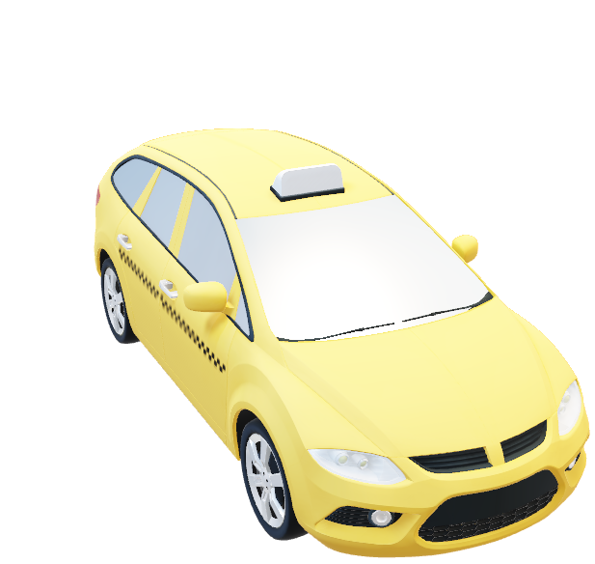
Agenda
Team Members
Background & Motivation
Problem Statement
Project Proposal
Dataset Source
Inclusion Criteria
Data Analysis
Conclusion & Recommendation

Slide 3







Team Members
Jigar Patel
Niren Patel
Parth Brahmbhatt
in/jigar-patel-a4157821b
in/niren-patel-550995221
in/parth-brahmbhatt-1452291b4

Slide 4

Problem Statement
In 2014 and 2015, the demand for Uber in New York City rose. This demand, however, may not be evenly spread, either locally or temporally.
Uber is a taxi and transportation network that operates through an app. Passengers may have to wait a long period for a cab due to a lack of availability of cars, or the cab may be cancelled.
Overall, these issues impact the business of Uber, and it loses out on its revenue.

Slide 5

Project Proposal
In this project, our primary approach is to use Exploratory Data Analysis (EDA) to identify problems or suggestion, Data Cleaning, and add Visualization by plotting various graphs with proper aesthetics and geometry, clearly displaying important insights.
Identifying the problems which is useful to maintain demand and supply for customers.
Try to provide more efficient solutions which is direct benefit to Uber and their customers.

Slide 6


Dataset Source
How was the data collected?
The dataset of Uber Pickups in NYC, we find from the “data.world”.
https://data.world/data-society/uber-pickups-in-nyc

Slide 7

Inclusion Criteria
The key features of our dataset is for target population which are we listed below:
License Base number
Location ID
Number of Vehicle & Trips
Time Period(Hour, Day, Week, Month, Date)

Slide 8
DATA ANALYSIS

Slide 9
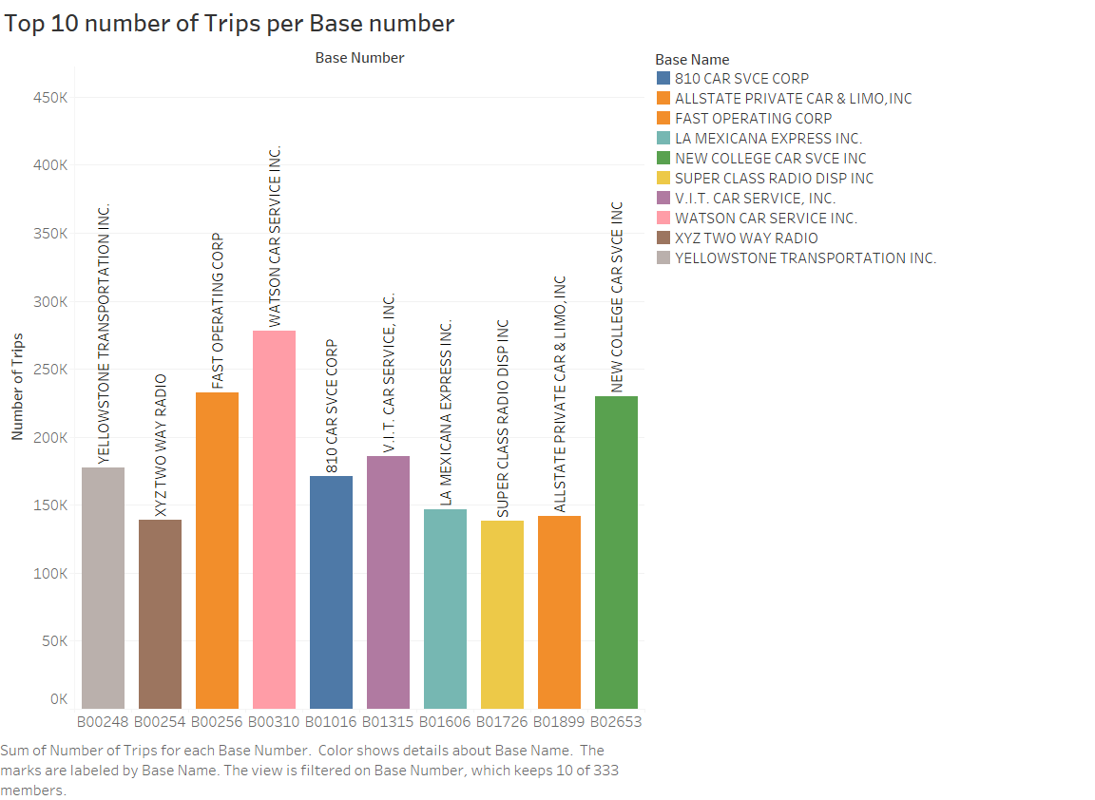
Top 10 number of Trips per Base in 2015
According to the chart Watson Car Service base number has the highest number of trips, whereas Super Class Radio Disp INC base number has the least number of trips.

Slide 10
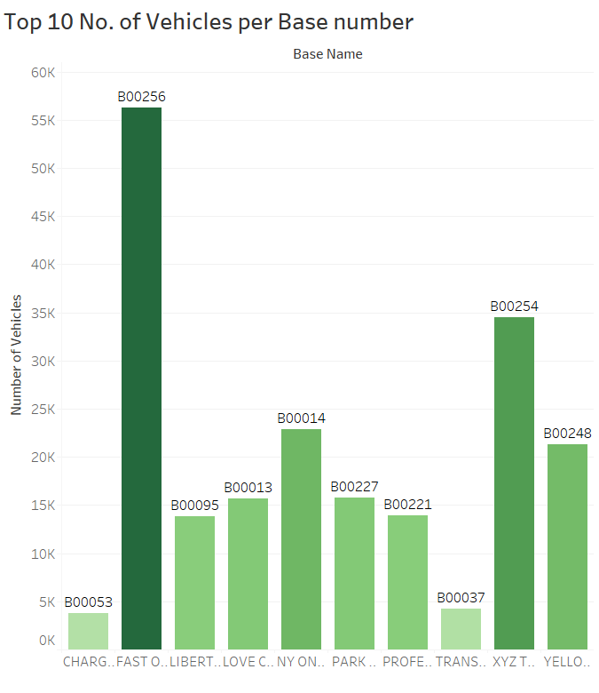
Top 10 No. of Vehicles per Base number in 2015
As can be seen, the Fast Operating Corp base number has the most vehicles, followed by the XYZ Two Way Radio base number, which has the second most vehicles.

Slide 11
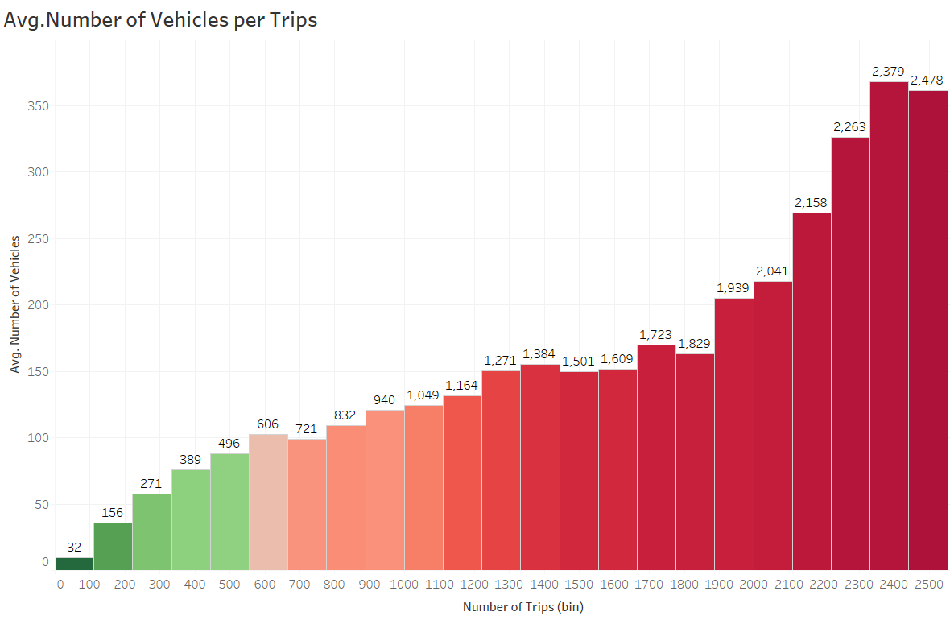
Avg. Number of Vehicles per Trips in 2015
The graph clearly shows that the average number of trips is increasing.

Slide 12
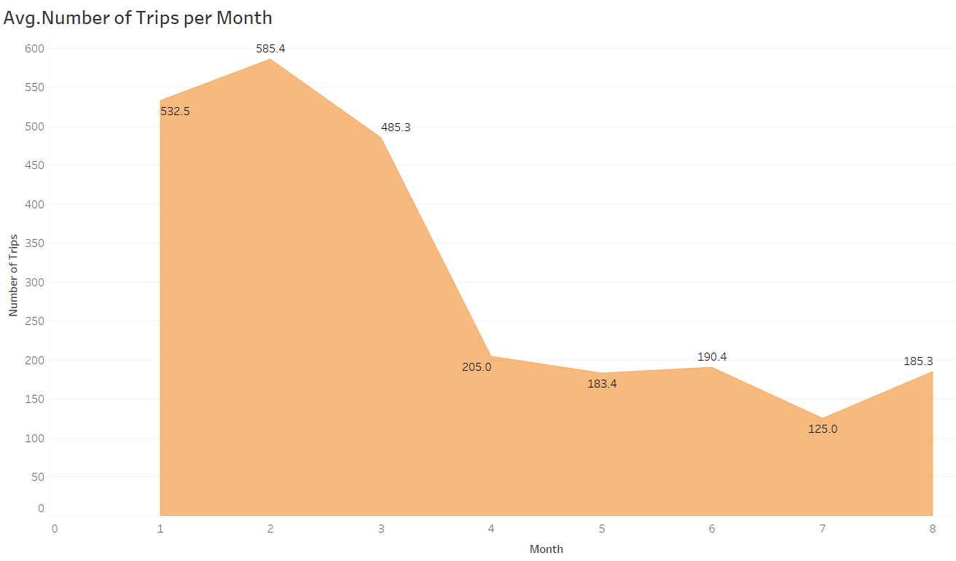
Avg. Number of Trips per Month in 2015
In 2015, February had the highest average number of trips, but after March, it began to fall through August.

Slide 13
DATA PRODUCT IN TABLEAU

Slide 14
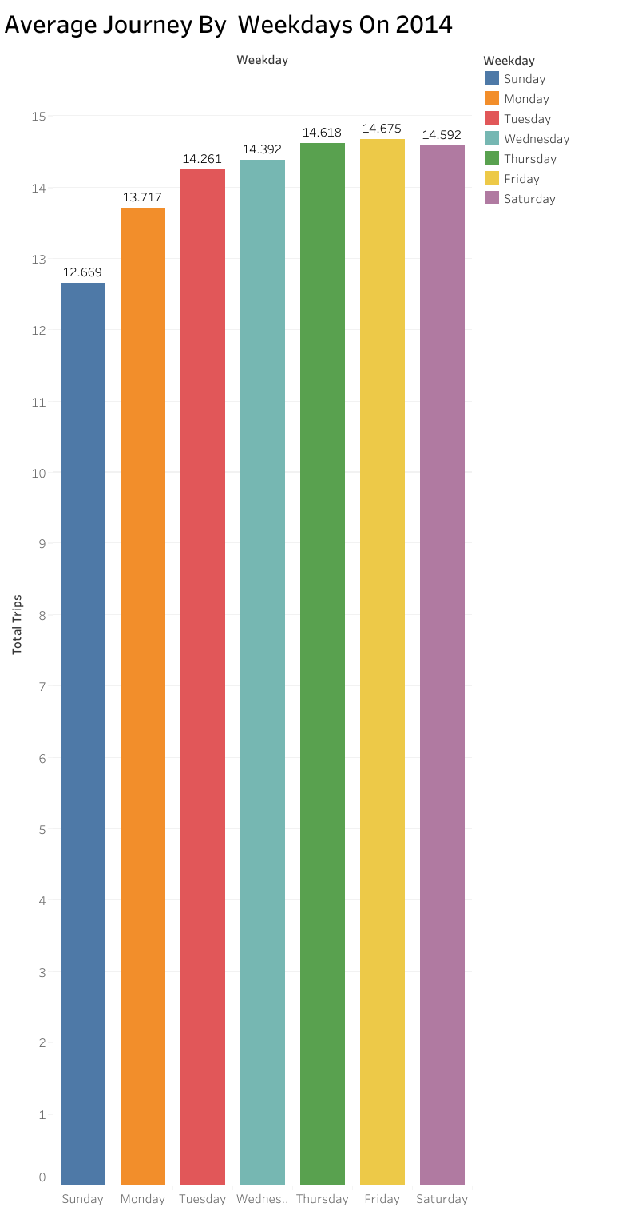
In the last three days of the week in 2014 there are more pick up rate.
So, In respect to that customer should have to travel less in the last three weekdays.

Slide 15
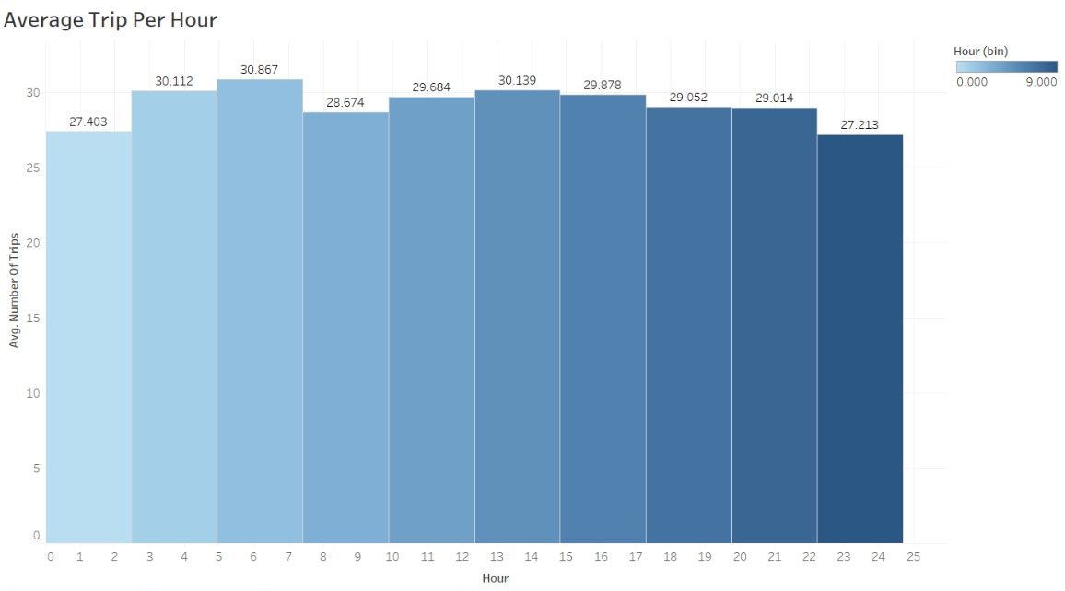
From 3:00 to 7:00 hour there are almost similar trips ratio and in the starting hour (1:00 to 2:00) and ending hour (22:00 to 24:00) of the day.

Slide 16
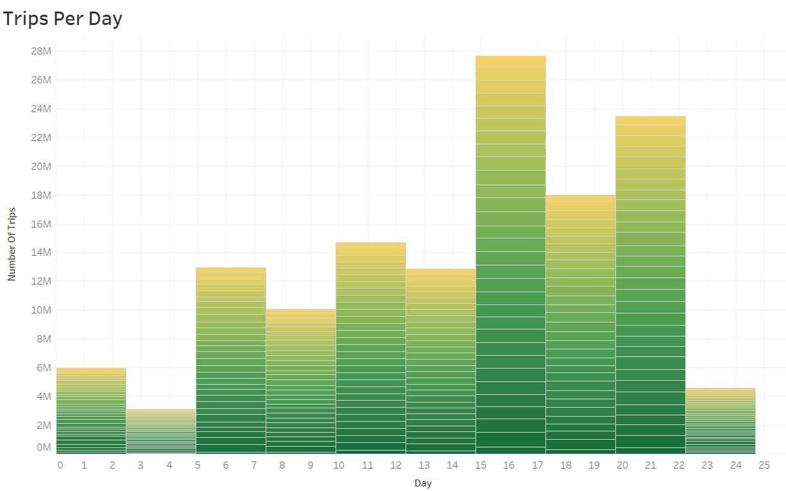
According to the chart there are more pick up rates between 15th to 17th day in an average month in 2014.

Slide 17
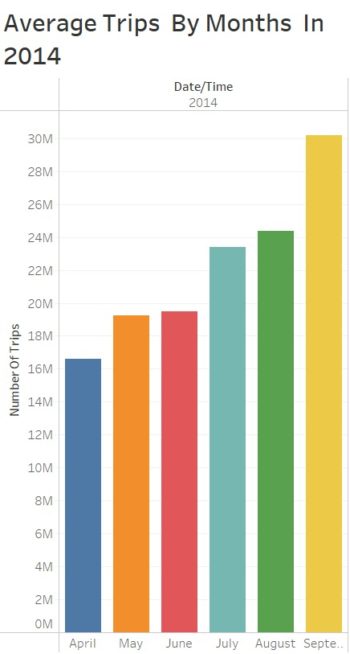
Among the described six months of 2014, the month of September shows that it has about 29M (million) average Trips in that month with the highest number.
So, as we can assume that during the fall people like to travel in the month of September, and less like to travel in the month of the April.

Slide 18
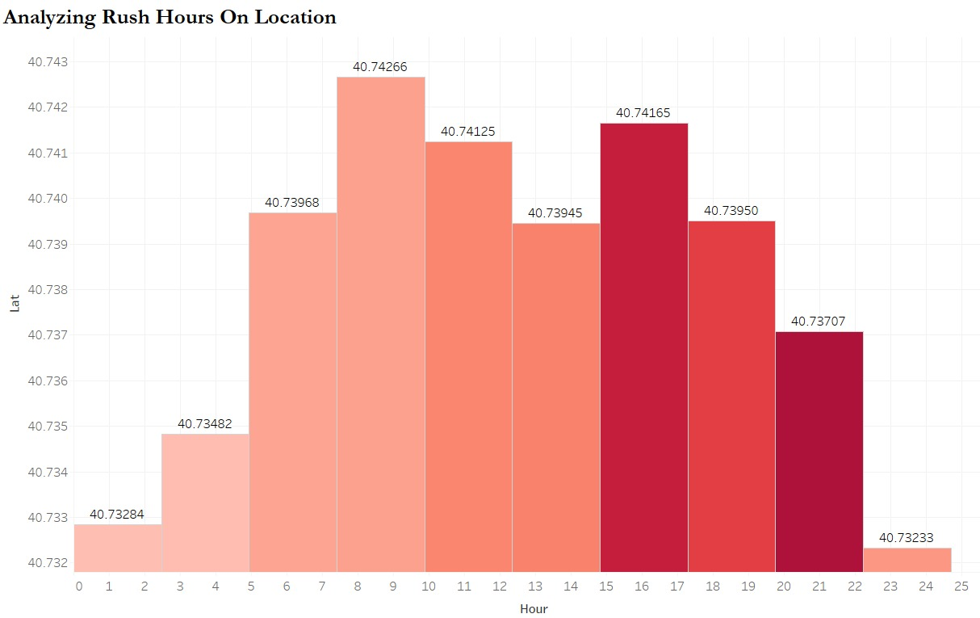
The rush hour of the day during 7:30 AM to 10:00 AM it seems that there are more rush hours on location between 40.732 Latitude to 40.742 Latitude.

Slide 19
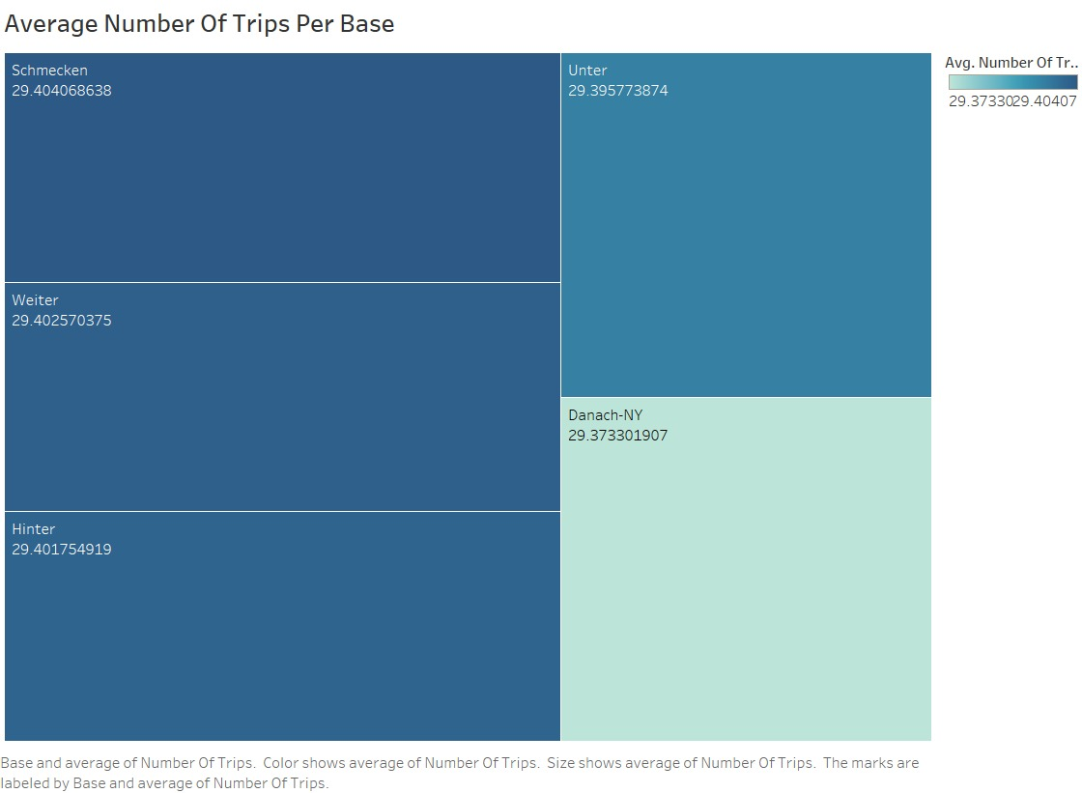
We can see in the tree map that the Schmecken(license base number) has more average number of Trips with 29.404 number among other base code.

Slide 20
Conclusion
We were able to obtain the following information from our examination of the Uber Pickups in New York City data set:
In 2014, Thursdays had the largest number of rides compared to the other weekdays throughout a six-month period. Meanwhile, the busiest hour of the day, according to the data, is 17:00, whereas uber cabs appear to be less busy between 2:00 and 4:00.
As shown in the graph, September is the month with the most trips, whilst April has the fewest.
As can be observed, there are more travelers on Tuesday at 40.744 latitude during rush hour, which lasts around 10 hours.
In comparison to the others, Weiter is the most popular base, as shown in the graph, and its demand is increasing month by month, as shown in the graph.
As the demand for cabs increases, the pickup rate will increase.
Danach-NY is one such base number which is highly active according to the chart.
It has been seen that the trips are more in the beginning month of the year rather than the end month of the year.
Base number Fast Operating Corp (B00256) has the highest number of vehicles whereas the number of the pickup rates stand at the second position among the other base number.

Slide 21
Recommendations
Following are the recommendations from our project :
According to our analysis Manhattan has highest number of pickups, so if uber can supply more number of cabs during in that area then it will help to slow down the rush and can work smoothly, and it will help to boost the economy of the New York City, simultaneously it will save time for the costumer.
It has been seen that cabs are not busy during noon hours whereas cabs are more busier during evening. So, if the passenger want to book a cab they must have to look into which hour have less pick up rate. By applying this method, costumer will not face any type of issues such as heavy rush.

Slide 22
References
Fischer-Baum, R. (2015, October 13). Uber Is Taking Millions Of Manhattan Rides Away From Taxis. Retrieved July 2016, from FiveThirtyEight.com: http://fivethirtyeight.com/features/uber-is-taking-millions-of-manhattan-rides-away-360 from-taxis/
Kaggle: Your Machine Learning and Data Science Community
https://data.world/
public.tableau.com

Slide 23




A Public Code Repository
https://public.tableau.com/app/profile/niren.patel6412/viz/UberTripsInNYC/Dashboard1?publish=yes
https://github.com/jigarpatel1910/Uber-Pickups-in-New-York-City

Slide 24
Dataset Description
This data contains on over 4.5 million Uber pickups in New York City from April to September 2014, and 14.3 million more Uber pickups from January to June 2015. Trip-level data on 10 other for-hire vehicle (FHV) companies, as well as aggregated data for 329 FHV companies, is also included. All the files are as they were received on August 3, Sept. 15 and Sept. 22, 2015.
The dataset contains, roughly, four groups of files:
Uber trip data from 2014 (April - September), separated by month, with detailed location information
Uber trip data from 2015 (January - June), with less fine-grained location information
Non-Uber FHV (For-Hire Vehicle) trips. The trip information varies by company, but can include day of trip, time of trip, pickup location, driver's for-hire license number, and vehicle's for-hire license number.
Aggregate ride and vehicle statistics for all FHV companies (and, occasionally, for taxi companies)

Slide 25
About Dataset
1) Uber trip data from 2014
There are six csv files of data on Uber pickups in New York City from April to September 2014. Each file contains data for a particular month, and each has the following columns:
Date/Time : The date and time of the Uber pickup Lat : The latitude of the Uber pickup Lon : The longitude of the Uber pickup Base : The TLC base company code affiliated with the Uber pickup

Slide 26
About Dataset
2) Uber trip data from 2015
Also included is the file uber-raw-data-janjune-15.csv This file has the following columns:
Dispatching_base_num : The TLC base company code of the base that dispatched the Uber
Pickup_date : The date and time of the Uber pickup
Affiliated_base_num : The TLC base company code affiliated with the Uber pickup
locationID : The pickup location ID affiliated with the Uber pickup
The Base codes are for the following Uber bases:
B02512 : Unter
B02598 : Hinter
B02617 : Weiter
B02682 : Schmecken
B02764 : Danach-NY
B02765 : Grun
B02835 : Dreist
B02836 : Drinnen
For coarse-grained location information from these pickups, the file taxi-zone-lookup.csv shows the taxi Zone (essentially, neighborhood) and Borough for each locationID

Slide 27
About Dataset
3) Non-Uber FHV trips
The dataset also contains 10 files of raw data on pickups from 10 for-hire vehicle (FHV) companies. The trip information varies by company, but can include day of trip, time of trip, pickup location, driver's for-hire license number, and vehicle's for-hire license number.
4) Aggregate Statistics
There is also a file other-FHV-data-jan-aug-2015.csv containing daily pickup data for 329 FHV companies from January 2015 through August 2015.
The file Uber-Jan-Feb-FOIL.csv contains aggregated daily Uber trip statistics in January and February 2015.

Slide 28
Data Cleaning & Transformation
The variable "Affiliated base num" has a NULL value in our dataset, we have eliminated those null values from the variable.
When we look at the data types, we discover that date/time is an object data type. However, we must convert it to datetime format, thus we use the data transformation tool to do so.

Slide 29


EDA Questions
Analyzing by Time
Q1. How many trips in an hour & each days?
Q2. How many trips in a weekdays?
Q3. Which month has maximum rides?
Q4. How many total rides per month?
Q5. Which is the busiest hour in the day for Uber cabs?

Slide 30



EDA Questions
Analyzing by Location
Analyzing by Base Number
Q1. On which location pickup number are more?
Q1. Which base number had more pickup number?
Q2. On which location the more rush in hour ?
Q2. How many pickups of Uber by Base number in a month?

Slide 31
EDA Analysis
Is there any missing, incomplete or invalid records in dataset?
In our dataset, there are no null or missing value for Apr-Sept 2014. However, Uber trip data from 2015 file consists about “162195” null value in Affiliated_base_num column, which is removed and make the data clearer for the further use.
Is there any outliers in dataset?
In our dataset, there are no outliers available.

Slide 32

Question: Relationship between Variables
What is the relationship between the no. of trips per location?
What is the relationship of journey to the weekdays?
What is the relationship of pickup per base number?
What is the relationship of the active vehicle to the dispatching base number?

Slide 33
EDA Visualization

Slide 34
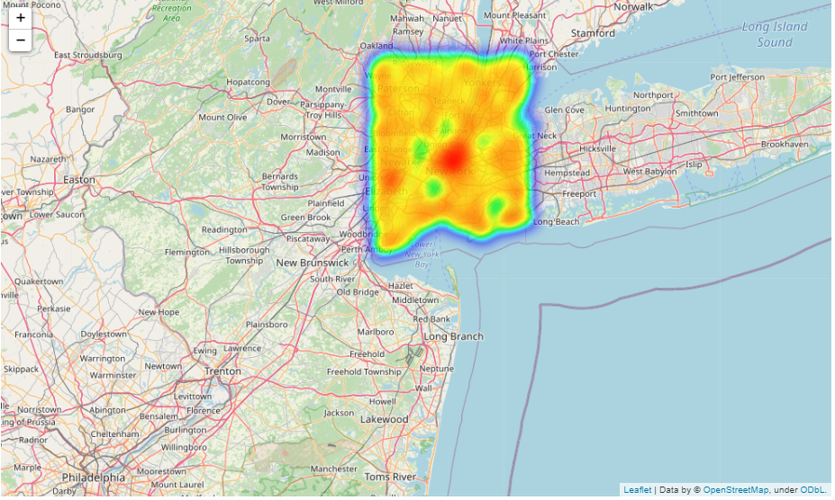
1) Heat Map of Total Pickups in NYC
On which location pickup number are more?
We can see from the map that Midtown and Downtown(especially) Manhattan have a lot of uber pickups, which is understandable, and that locations like The Bronx, Queens, and Brooklyn have much fewer pickups. Uber pickups are plentiful in the JFK Airport region.

Slide 35
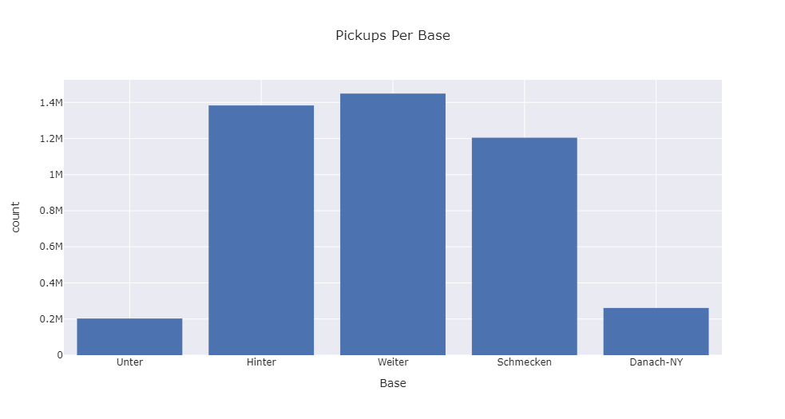
2) Distribution of Uber Pickups among the Bases
Which base number had more pickup number?
It's easy to see why Weiter had the most pickups(1.45M), followed by Hinter and Schmecken. This is most likely due to the fact that these locations are densely populated. Unter had the fewest pickups, at fewer than 0.2 million.

Slide 36
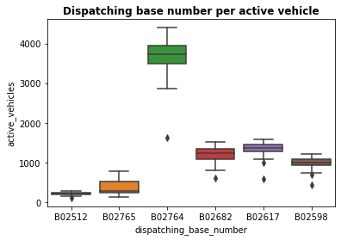
3) Active vehicle by base number
Which base number has more active vehicle?
As we can see in the plot that there is a least number of active vehicles of base number "B02512", while the more active number of vehicles of base number "B02764".

Slide 37
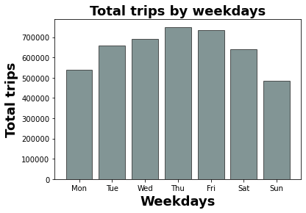
4) Trips per weekdays
How many trips per weekdays?
Surprisingly, on Thursday, there were more rides(more than 700,000)! Friday was right behind it. Even on Wednesday and Tuesday, there were more rides than on Saturdays.

Slide 38
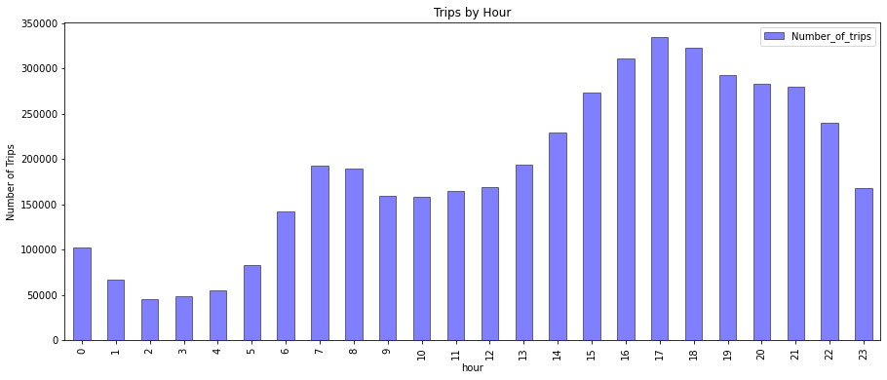
5) Trips per hour
How many trips per hour?
As we can see that from the graph that the busiest hour of the day is 17:00, while it seems that uber cabs are not that much busy around 2:00 to 4:00 hours.

Slide 39
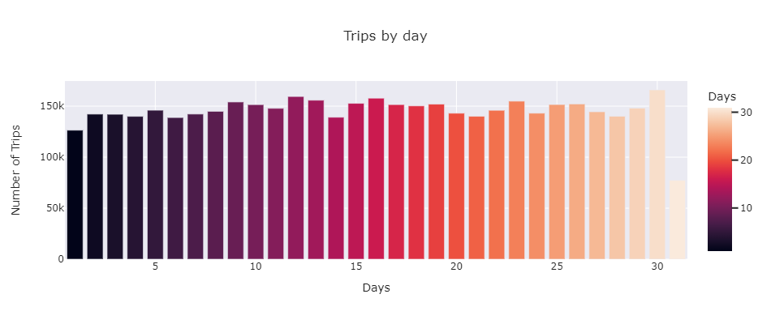
6) Trips per day
How many trips per day?
The day with the highest number of trips is the 30. There's not much variation from day to day.

Slide 40
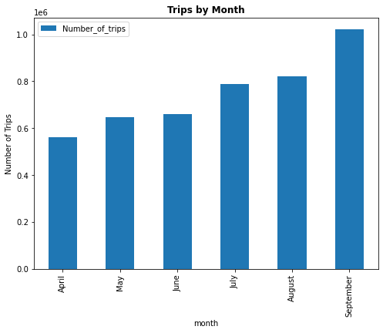
7) Trips per month
How many trips per month?
As we can see from the graph that September stands out to be the month were highest number of trips has been done, whereas April is the month were there are not much number of trips.

Slide 41
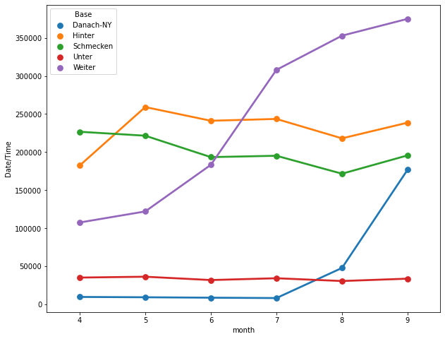
8) Analyze which base number gets popular by month
Which base number gets more popular by month?
As shown by the the graph, Weiter is the most popular base in comparison to the others, and its demand is growing month by month as it has increasing trend.

Slide 42
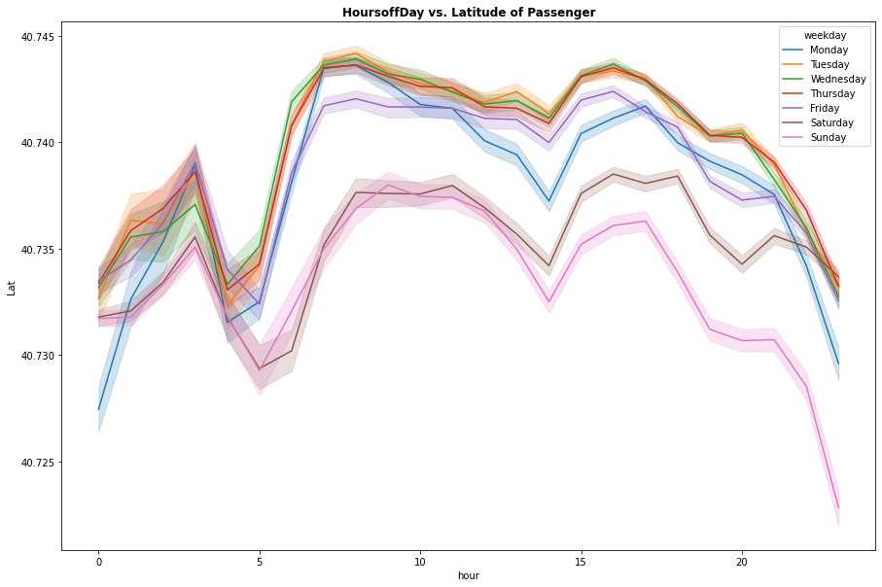
9) Analyzing rush hours on location
On which location the more rush in hour ?
As can be seen, on Tuesday at 40.744 latitude, there are more travelers during rush hour, which lasts roughly 10 hours.

